Slide 1

Easy Travels
The best solution for your journey

Slide 2
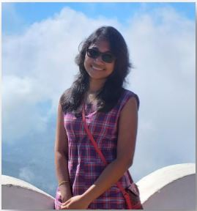
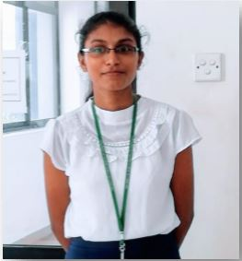
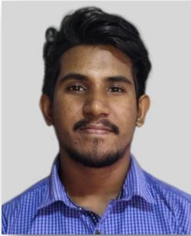
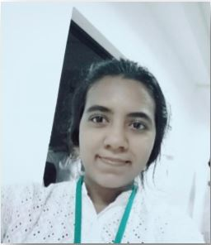
Group members
Asini Pathmila Silva
18020798
Ruwanthi Hemachandra
18020291
Hansaka Sandaruwan
18020704
Sachini
Maleesha
18020356

Slide 3
Introduction
Many people have to face some issues when they are organizing a journey.
The budget of the travel plan.
Finding hotel booking options that are relevant to their plan.
Finding a vehicle relevant to the number of travelers.
Having less knowledge about the places to visit.
Nowadays,
People are using websites to plan their journeys.
Those websites provide travel packages for various prices.
The main problem is those packages are designed for targeting foreign people not for local people.
So local people can’t think about those packages due to the budget.

Slide 4
From the proposed website,
Provides predefined and categorized travel packages.
If the user want to book a travel package, user has to select the package, fill his personal details, the number of travelers, and the number of rooms that he want.
According to the user requirements administrator will organize the journey.
The another functionality that we are going to have is the registration of the Hotels, guides and vehicles.
So those accounts will find customers through our web site.
As well administrator will be able to organize the journey easily.

Slide 5
Project Description
With in the boundary
Predefine packages.
User can’t select the hotel, guide, or the vehicle for the journey.
Admin will select hotel, guide, and the vehicle according to the user requirements and the price of the travel package.
Users will be able to put comments, send messages, search travel packages, and view destinations.
The administrator has the authority to add, update, delete the travel packages, categories, subcategories, and destinations.

Slide 6
The administrator can view the messages which are sent by users. But he uses manual process to react those massages.
User, Hotel, Vehicle, and Guide accounts have the authority to update or delete their accounts.
Hotel can update the availability by changing the number of rooms based on the room’s type.
The Vehicle and Guide accounts can update whether they are available or not.
We are going to have a sandbox for the payments.

Slide 7
Out of boundary
We are not implement the payment gateway for the payments.
The administrator doesn’t use system to organize the journeys. He manually contacts the available hotels, guides, and vehicles according to the user requirements.
The administrator doesn’t use the system to react for the user messages. So it will be an out of boundary activity.

Slide 8
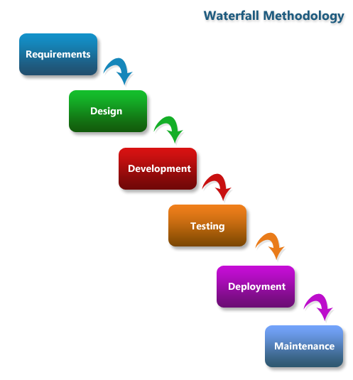
Methodology
We are going to use Waterfall Model as the development methodology.
We choose this model because,
Our second year group project is milestone-focused project. So we have to go step by step by achieving those milestones. Waterfall model is the best developing model for milestone-focused project.
We are defining the scope at the beginning of the project. So we have found clear requirements. If there is clear requirements, Waterfall model is the best solution.
As well we are defining the technologies at the beginning. So because of that there is no chance to change those technologies during the developing period.

Slide 9
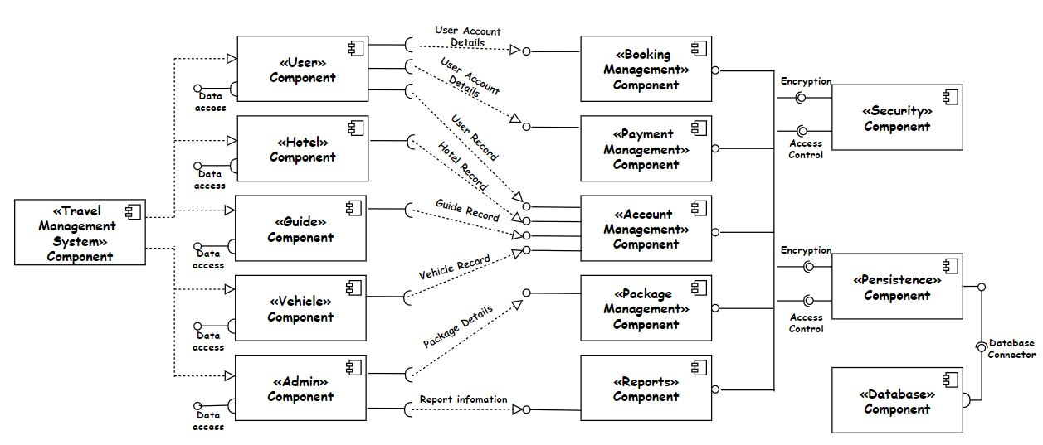
Component Diagram

Slide 10
Description of the Component Diagram
There are five main actors in our system. Admin, User, Hotel, Guide and Vehicle. Therefore these actors are the main components of this component diagram.
When we consider these five main components requires following services.
User component – Booking Management, Payment Management, Account Management
Admin component – Account Management, Package Management, Report Management
Hotel component – Account Management
Vehicle component – Account Management
Guide component – Account Management
When we consider about the Booking Management it provides services to the User.
Then if we consider about the Payment Management it provides services to the User.

Slide 11
Now if we consider about Account Management it provides the services to the all the actors in this system like User, Admin, Hotel, Vehicle and the Guide.
When we consider the Package Management and the Report Management they provide services to the Admin.
Booking Management, Account Management, Package Management and Report Management requires the services from Security and Persistence components.
As the same security and Persistence components provide their service to the all the below management component.
And also Security and persistence component requires the services from the Database and as soon as possible database provides to service to this through database connector.

Slide 12
Work Load Distribution
User functionalities – By Asini
Admin functionalities – By Asini
Hotel functionalities – By Ruwanthi
Guide functionalities – By Hansaka
Vehicle functionalities – By Sachini

Slide 13





User Identification
Considering the our system we can introduce five main actors.
USER
HOTEL
GUIDE
VEHICLE
Admin

Slide 14
Functional Requirements

Slide 15
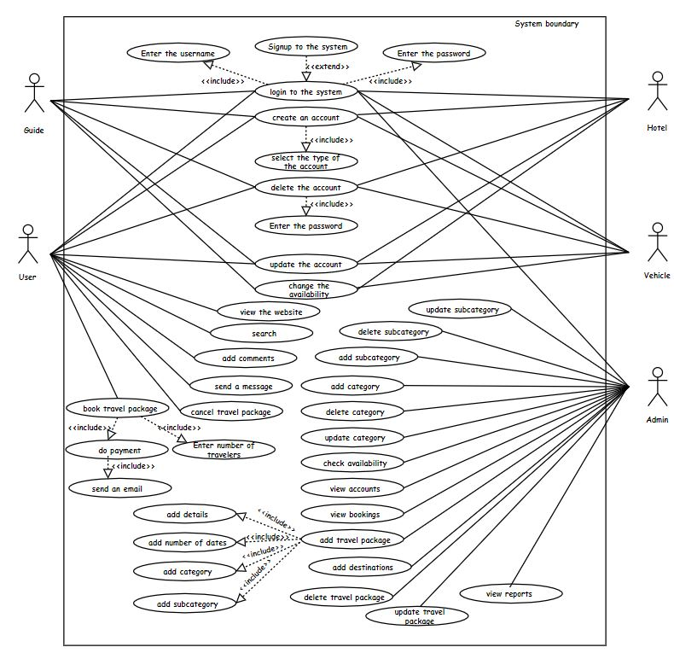
Use case Diagram

Slide 16
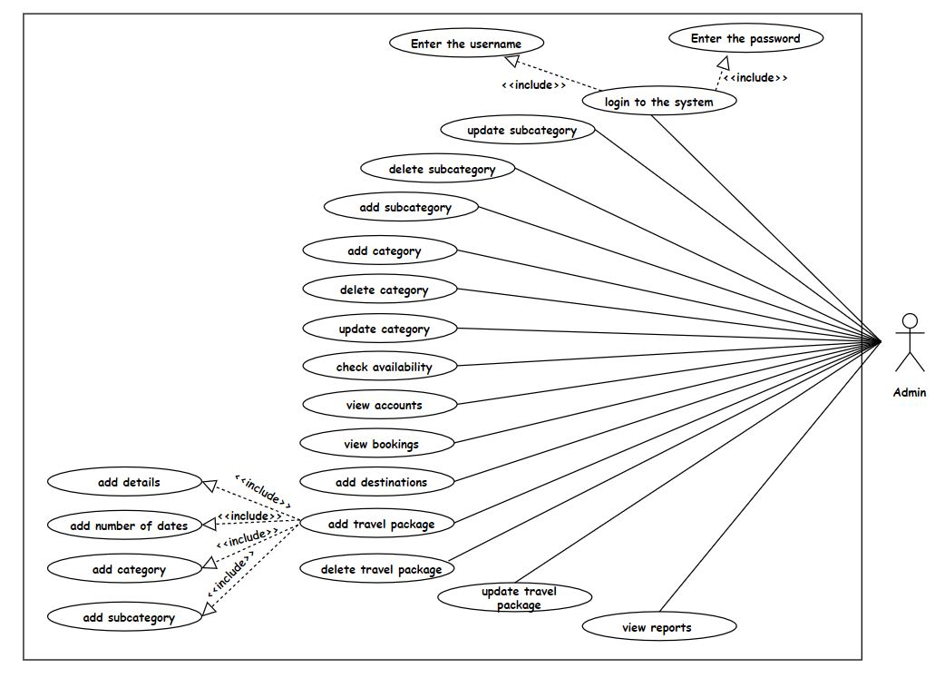
Admin

Slide 17
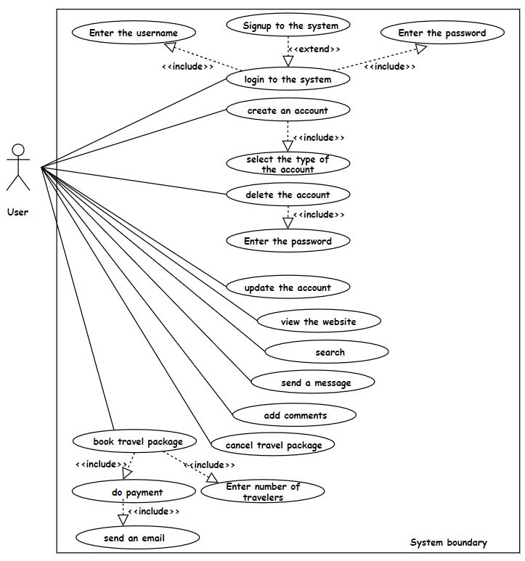
User

Slide 18
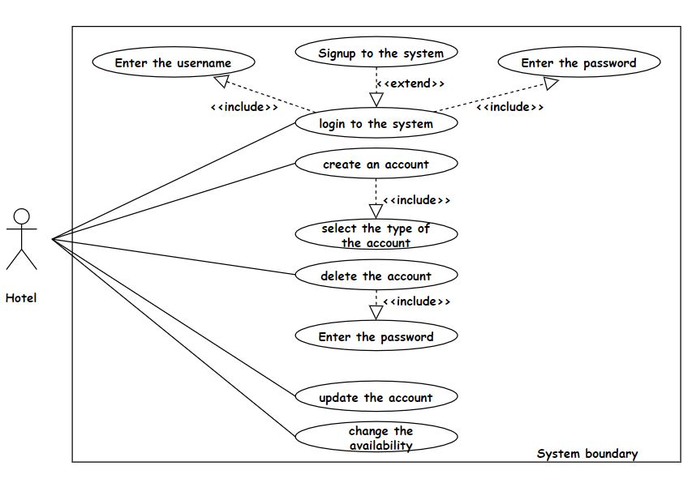
Hotel

Slide 19
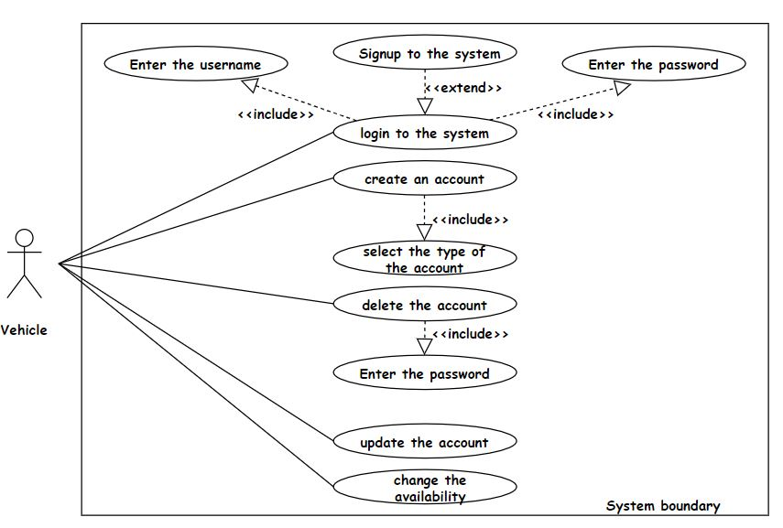

Vehicle

Slide 20
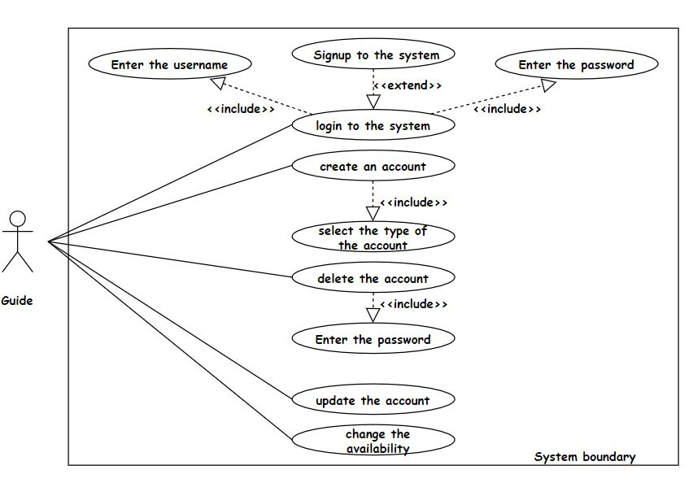
Guide

Slide 21
Non-Functional Requirements

Slide 22
Security
Required passwords should be longer than 12 characters.
Password recovery option
Password will save on the database in an encrypted manner.
The forms are validated with the required fields.
Data backup option (In phpMyAdmin database has an option to export data from the database.)
Performance
We can improve the performance of the website by speeding the process, decrease the response time, etc.
We use PHP programming language for back-end development. So because of that applications can be easily loaded over the slow internet and data speed.
We can use minify and combine files to reduce the size of each file as well as the total number of files. From that system's performance will be improved.
We can use session variables to pass data.

Slide 23
3. Usability
We are planning to give our website to chosen users to check whether it is usable or not.
From this testing, we can identify what the user thinks about our website.
4. User-friendliness
The proposed website can be accessed easily.
Users will find travel packages very easily. Because all the packages are divided into categories and subcategories.
Considering the clean and clear user interfaces, it will help the user to access and affect the website.
We are planning to have user testing. So we can get an idea about how they feel about the user-friendliness of our website.

Slide 24
5. Portability
We are planning to implement our website responsively. So it will compatible with operating systems and also the mobiles.
So the can use any device to see a good output.
6. Maintainability
We will use readable codes which can easily understand.
We will use comments to identify the source codes. So code can easily change.
We will use automated codes. That will make the code easy to compile.
We will use automated validation parts.

Slide 25
Technologies to be used
Considering Programming languages
We use HTML, CSS, JavaScript for front-end.
We use PHP Back-end.
We use MySQL for database.
As the PHP software requirements we use
WAMP server [Microsoft Windows o/s, Apache MySQL PHP]
As the MySQL administrator tool we use
phpMyAdmin
As the Diagram drawing tool we use
drow.io

Slide 26
As documentation tools we use
Microsoft Word
Microsoft Excel
As the Project management software we use
Microsoft Project
We use this to create Gantt chart and timeline
As text editing tools we use
Visual Studio Code
Notepad++
As the contribution platform we use
GitHub

Slide 27
Feasibility Study
Technology feasibility
Technologies which are used by us, is freely available and technical skills required are manageable.
Front-end tools like HTML, CSS, JavaScript are easily compatible with our current hardware configuration
Back-end language, PHP is stable as compared to other programming languages and platform-independent.
Economic feasibility
According to our project, our development cost will be zero because we use open source software and freely available tools.
Now we will use the test mode of a payment gateway but when the website hosts we have to pay for the payment gateway.

Slide 28
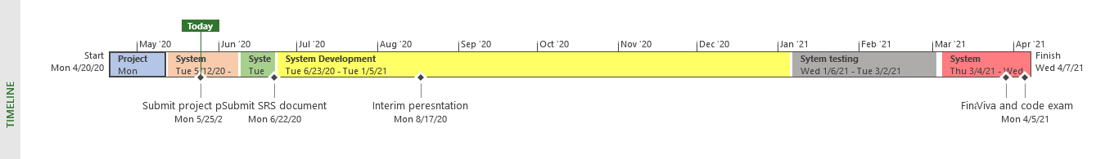
Legal and Ethical feasibility
When we consider our project we are using freely available tools and open-source software.
Our system will not save the users’ sensitive data like credit card information.
Schedule feasibility
We have one year to complete the project. So we are going to plan the project according to the following time line.

Slide 29
Operational feasibility
When considering the proposed system, it will provide more benefits. If the user plan a journey he has to pay the cost separately. But in our scenario, the cost will be based on the travel package. So it is economically benefited for the user.
Not only the user, the other accounts hotel, guide, and the vehicle will also get benefits. If they are hiring themselves that will be a big cost more than they registered on this website. So the only thing they have to do is change their availability on this website. So they will get advantages from our website.

Slide 30
THANK YOU

Slide 31
Vehicle can’t be an actor make it as vehicle owner.
Functional requirements can introduce using individual usecases.
Take one Goal and give others as objectives other
How do you make Packages.
How do you get the agreements in hotels.
User friendliness- Why you are telling as “The proposed website can be accessed easily”
How the Session variables can use in the performance part.
What do you mean by Automated codes
Who does make the packages
How do you make the packages
How you assume the Packages’ prices
What are the Reports
How you get to know those accounts are available or not-Available list
Is there any relationship between guide and hotel?
How do those accounts change availability-daily
How you define hotels to the package

